Slide 1



NDEM
February 13, 2015

Slide 2
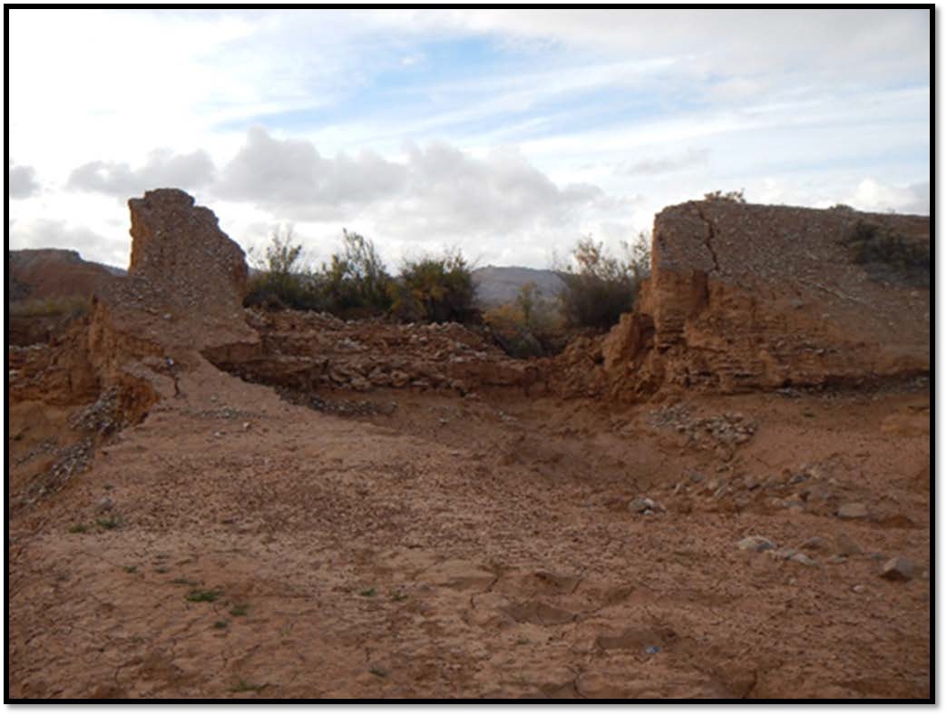
FEMA-4202-DR-NV
Severe Storms and Flooding Transition Brief
MARK H. LANDRY FEDERAL COORDINATING OFFICER
CHRIS SMITH STATE COORDINATING
OFFICER
February 13, 2015

Slide 3
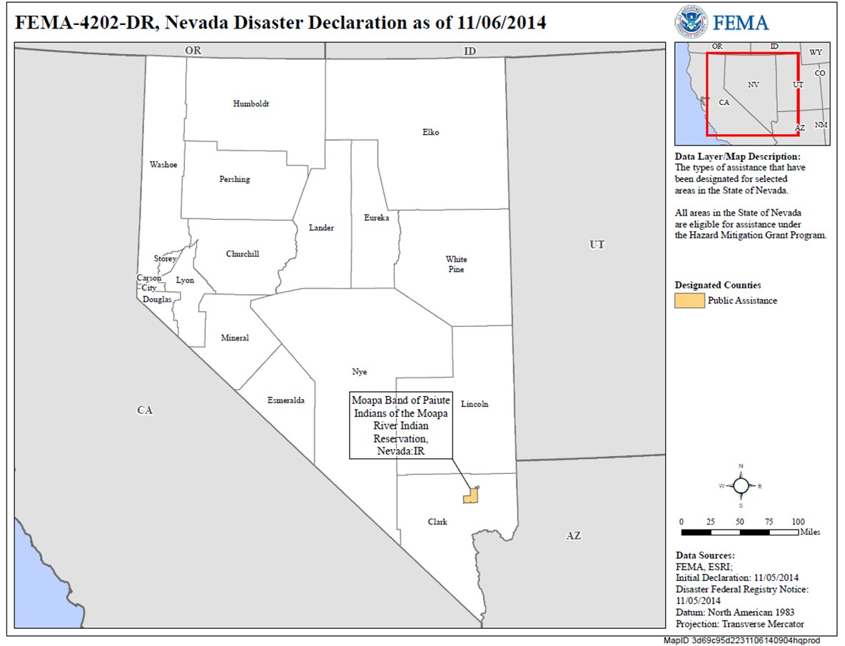
Event Summary & Designated Counties
September 7 – 9, 2014 Severe Storms/Flooding Incident Period
• September 10 – 13, 2014 Preliminary Damage Assessments performed
October 22, 2014 Governor requests Clark County and the Moapa Band of Paiutes Tribal Reservation, and Hazard Mitigation Statewide
November 5, 2014 President declares major disaster for Public Assistance (Cat. A-G) for The Moapa Band of Paiutes Reservation and HM Statewide
February 13, 2015

Slide 4
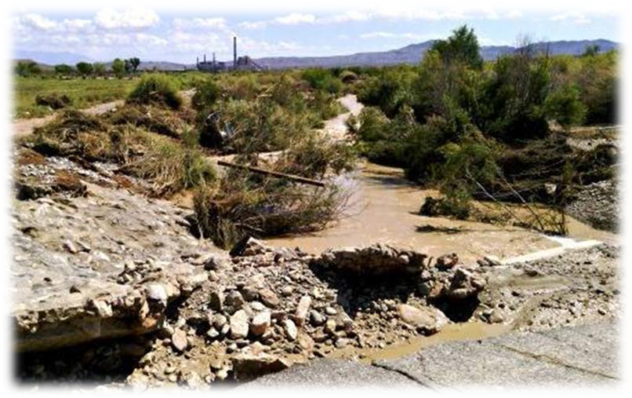
Preliminary Damages
PDAs Conducted September 10-13, 2014
$1.4 M Total Estimated Damages
Cat A – $95 K
Cat B – $107 K
Cat C – $581 K
Cat D – $37 K
Cat E – $81 K
Cat F – $466 K
Cat G –$30 K

Slide 5
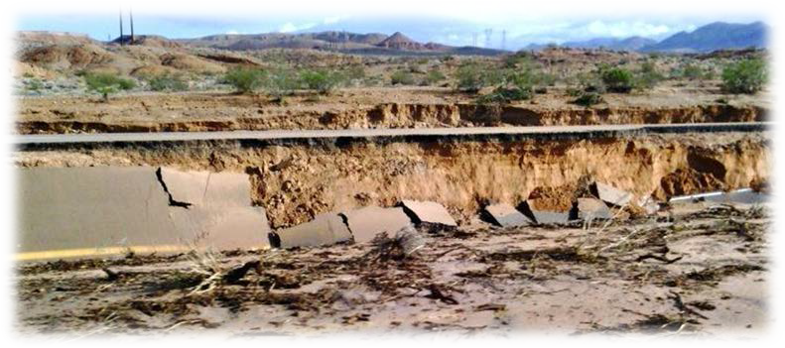
Master List of Joint Objectives
MASTER LIST OF JOINT OBJECTIVES:
1 | Submit Public Assistance (PA) Addendum to the State Administrative Plan
2 | Develop and submit preliminary Spend Plan figures
3 | Conduct External Affairs Outreach Program to provide information to elected officials and Applicants/Sub Applicants for recovery program implementation
3a | Conduct Joint External Affairs Outreach Program to provide information to elected officials and Applicants/Sub Applicants for recovery program implementation
4 | Develop Project Worksheets (PWs) spreadsheet
4a | Develop Project Worksheets (PWs)
5 | Initiate Tribal Hazard Mitigation Planning Process
5a | Facilitate Tribal Hazard Mitigation Planning Process
6 | Finalize EHP Green Book by 12/12/2014

Slide 6
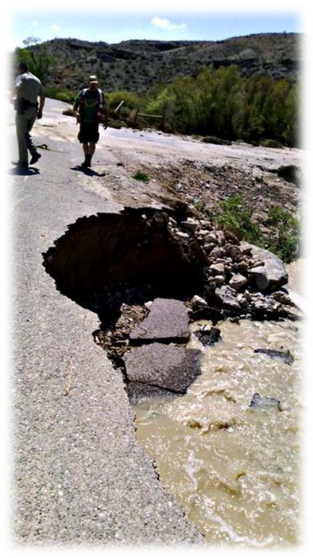
Public Assistance
SYNOPSIS: As of 02/10/2015
Reviewed 2 of 2 RPAs for eligibility
Conducted 100% Applicant’s Briefings
Kick-Off Meetings 100% completed
STATUS
Estimated PWs: | 20
PWs entered into EMMIE: | 8
Percent Complete: | 36%
PWs Obligated: | 1
Dollars Obligated: | $47,558
Fed Share Requested: | $649,044
Current Projected 100% | $2,436,257

Slide 7
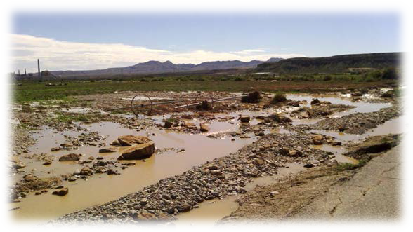

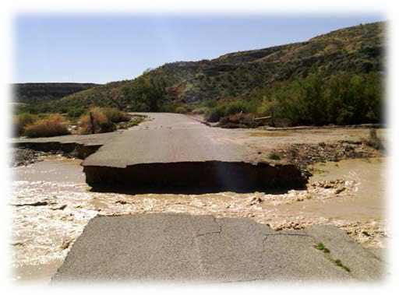
Public Assistance Continued
PROJECTED PROJECT WORKSHEETS:
Cat. | Count | Projected Costs
A | 1 | $ 97,181.00
B | 4 | $ 204,487.65
C | 2 | $ 563,127.00
D | 4 | $ 704,007.20
E | 2 | $ 335,260.92
F | 3 | $ 221,215.55
G | 4 | $ 311,248.54

Slide 8
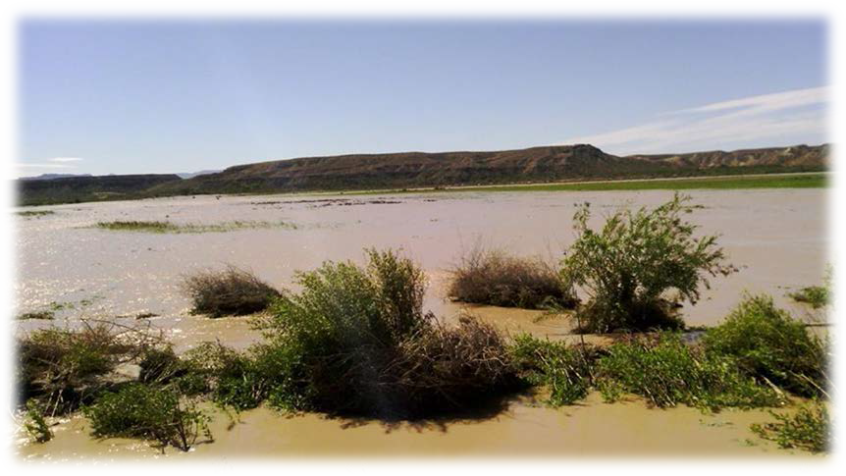
Environmental & Historic Preservation
SYNOPSIS:
Closure action: Ensure all issues are addressed and PWs are reviewed for Environmental
Compliance
Will continue consultation with the State Historic Preservation Officer (SHPO), the US Fish and Wildlife Service, and the US Army Corp of Engineers for project reviews
STATUS:
No current issues

Slide 9

External Affairs
SYNOPSIS:
Maintained disaster website, conducted social media outreach via Twitter
Coordinated Public Affairs Outreach that resulted in 7 stories in local media (print, broadcast and online)
Conducted multiple congressional staff briefings
Supported staff at applicant’s briefing
Coordinated joint outreach with state and tribal counterparts
STATUS:
No current issues

Slide 10




















Financial Report
$350,000
$300,000
FEMA Support by Location
4
18%
$250,000
$200,000
1
5%
11
50%
$150,000
6
27%
$100,000
$50,000
Oakland, CA Nevada
Mather, CA Other
$-
Allocations Availible
Availible Expenditures Coms., Obs.,
Funds Availible
Requested Commitments Obligations
& Exp.
*Data current as of 06FEB15

Slide 11
Discussion
PARTNERSHIP: Moapa Band of Paiute Indians – Nevada Division of Emergency Management – Federal Emergency Management Agency
Natural Resource Conservation Service
Eligibility For Funding Farm Irrigation Equipment
Project Management
Emergency Work, [Category A & B] 6 Months
Permanent Work, 18 Months
Contracting vs Force Account
Record Keeping
Project Closeout
Outstanding Issues ?

Slide 12
The Transition
Chris Smith
State Coordinating Officer
Mark Landry
Federal Coordinating Officer

Slide 13
Support Staff Transition
Virtual Joint Field Office Post Closure Points of Contact
Section | Pre-Closure | Post-Closure Region IX Contacts As Of 02/10/2015 | Closure/Transition Actions
FCO | Mark Landry 617-680-1702 | Karen Armes, Acting* 510-627-7100 | Coordinate VJFO/FFO closure with State and FEMA HQ
FCO Executive Assistant | Beth Jowers 828-779-9381 | Aileen Butler 510-627-7104 | Prepare FCO closeout files for shipment to Region IX
External Affairs | Mary Simms 510-627-7006 | John Hamill 510-627-7054 | Forward all files and any open inquiries to Region IX EAO
Operations / Infrastructure | Denis Coliten 510-627-7261 | Denis Coliten 510-627-7261 | Continue oversight/coordination with State for final PW processing
EHP | Katerina Hardegen 510-627-7158 | Katerina Hardegen 510-627-7158 | Ensure all SGAs are reviewed and any issues resolved
Mitigation | Christopher Poehlmann 415-847-9479 | Robert McCord 510-627-7059 | Coordinate with the State for any unresolved HMGP issues
Planning | Troy Miller 510-851-2854 | Ian Dixon 510-627-7257 | Publish final Situation Report Ship archival files to Region IX
Logistics | Rod McAllister 202-384-6443 | Shawn Matz 510-627-7035 | Coordinate any remaining Logistics issues
Finance/Admin | Teresa Serata 202-384-6373 | Thomas Dupont 510-627-7757 | Transfer files to Region IX, complete time reports in accordance with check-out procedures

Slide 14
DISCUSSION
QUESTIONS
ADJOURN
GONE BUT NOT FORGOTTEN

